Slide 1
WHY?
WHY THIS?
WHY ME?
WHY DACXI?
WHY NOW?
Notes:
Why this? Why might someone be considering this – savings, assets, wealth building
Why Me? Who am I and what do I know about it?
Why Dacxi? Who are they? Global, Established, Unique
Why Now? I’ll tell you in a few minutes

Slide 2
WHY THIS – Why ‘Crypto’?
‘Crypto’ = Digital Assets (DA) = Asset Tokenisation
Protect your Assets against ‘Inflation’
DAs grow in value independent of the value of ‘ordinary’ Government money or ‘Digital Money’
Safe and Secure
Under your control
Future proof against economic disruption
Notes:
Digital Pounds, Dollars, Euros or Yuan are no different than the money we have right now – government money

Slide 3
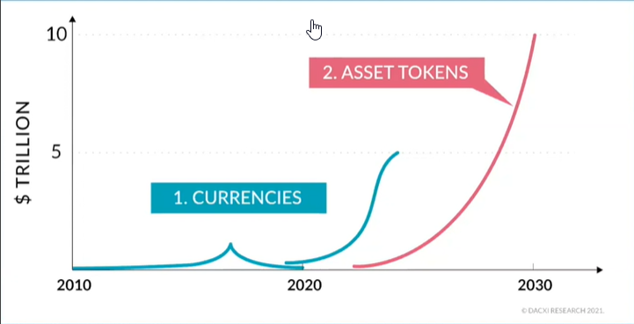
Digital Currencies -> Digital Assets
Notes:
Now at the lower end of the 2nd currency curve, tokenisation curve is starting right now

Slide 4
Why Me?
Notes:
Not a financial advisor, not employed by Dacxi, just a customer, ben engaged since 2019, understand how it all works – or know someone who does, understand the schemes and scams

Slide 5
Why Dacxi?
FCA Licence, AML and KYC
EU Licences
HM Treasury – Crypto UK
Global Reach
Bundle Strategy
Multiple Use Cases
Growth Potential
Notes:
FCA Temp Licence (the only form f licence available, EU Licences still apply for EU Clients, Dacxi on Crypto advisory board to Treasury, HMRC, FCA
Operating in Australia, UK and EU – 50 other countries coming on board soon, other offices in Brazil, Estonia and NZ, unique bundle strategy for maximum growth

Slide 6
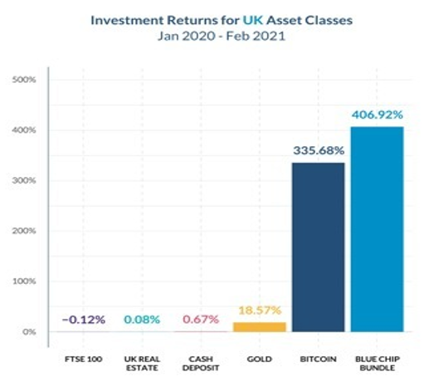
Blue Chip Bundle – Last 12 Months
Notes:
FTSE, Property, Cash doing nothing, Precious Metals low growth, Bundle much better than single coin

Slide 7
Security
Exchange Security
observatory.mozilla.org
Cold Wallet – 98%
Hot Wallet Covered by Cash
Notes:
Compare with others - put your bank into observatory.mozilla.org and see
Cold wallet held OFFLINE, no chance of theft
Remaining 2% covered by company cash funds

Slide 8
Dacxi Coin Use Cases

Slide 9
WHY NOW?
Blue Chip Growth
Dacxi Coin Bonus up to 30 Mar
Dacxi Coin Price Rise 30 Mar
Open Exchange Listing 29 Apr
Next Step . . .
Notes:
Growth has only just started – 40% extra Dacxi – Price rise coming March 30th – Listing on open exchange April 29th for sale to public – What to do next

Slide 10
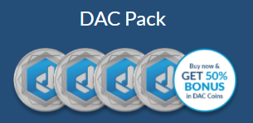
Options
Dacxi Coin price rises 20% on 30th March
100% Dacxi coins plus 40% Bonus coins until March 30 2021
Then discontinued
50% Bitcoin, 20% Ethereum, 20% Dacxi coin, 10% Litecoin
Minimum purchase £100
Notes:
After March 30th DACXI coins can be purchased but no bonus. Dacxi coin value rises 20% on March 30th

