Slide 1
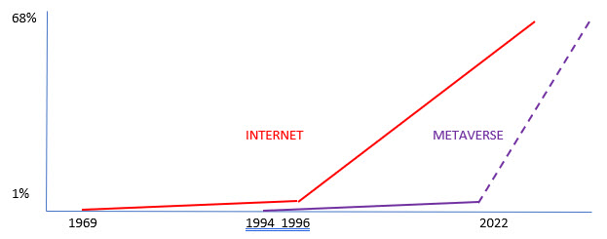
WHAT IS THE METAVERSE?
XR : 3rd dimension (physical) -> 4th dimension (mind)
Code on computer
Volume of metaverse = size of server. Size limited
2 dimensional webpage -> 3 dimensional ‘land’
Games + Fantasy -> Education + Business + Entertainment
What happened?
Webspace -> ‘Metaspace’ = Megaverus
WHAT IS MEGAVERUS - It’s not a game!
The Great Positive
Family friendly for Education, Business, Entertainment
Extranational, culture neutral - the place for positive people
Planet Friendly
Community based
WHAT’S IN IT FOR YOU?
LAND
shops, offices, entertainment, education. Use, sell or rent. Your ‘web page in the metaverse’
AMBASSADOR
Introduce people –> get paid commission
MEMBER
speaker, entertainer, promoter etc.

